Slide 1
Content Objective: Students will use post-it notes and create a gallery walk of information for 6 foundational ethical terms.
Tuesday Nov. 5
The Moral Compass
Ethical Theories of You
Ethical Theories of Us
Homework
During projects only...

Slide 2
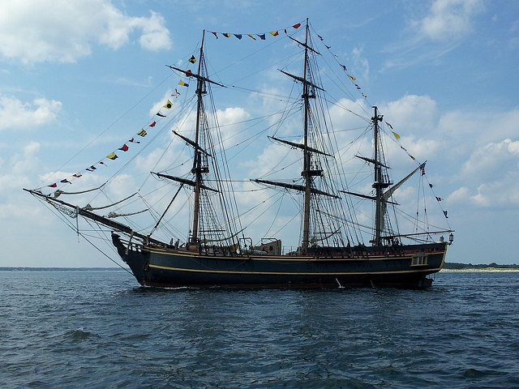
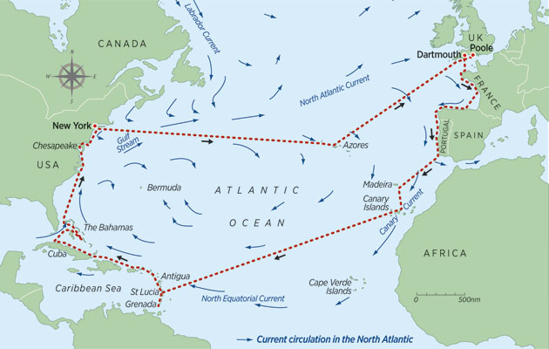

The Sea Captain Problem
The year is 1600 and you’re on a boat that is trying to sail across the ocean. What tool can you use to help you cross? What if you did not have that tool? What might happen to your boat?

Slide 3
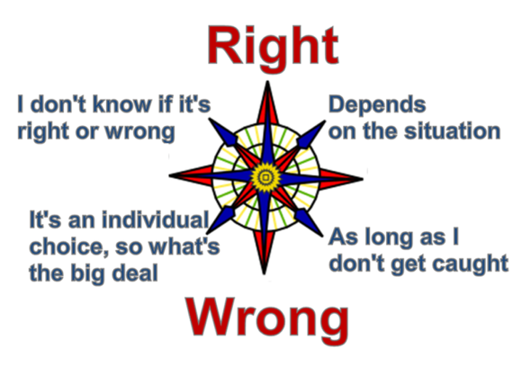
Moral Compass - Do You Have One?
What does a Compass do?
Do you need a Moral Compass to survive in life?

Slide 4
In order to build a moral compass we need to understand some basic ethical theories...
How do you personally act in certain situations? What do you believe in?
Absolutism?
Relativism?
Objectivism?
How does everyone decide on how to act? What does humanity believe in?
Deontology?
Consequentialism?
Virtue Ethics?

Slide 5
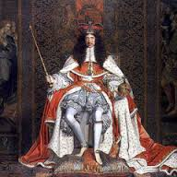
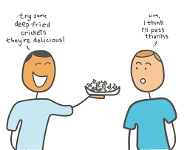

Absolutism Relativism Objectivism
This guy rules the land and says that slavery is bad and humans should be free. Should we give him more power if he has good morals?
Is this glass half full or half empty?
Is there a truth separate from human thought that just is?
Where does this truth come from?
You like eating deep fried crickets. I don’t. Who cares, it’s all relative!

Slide 6
Absolutism Relativism Objectivism
Use post-it notes / gallery walk style.
Large Group Cardboard Posters to be Hung in Class

Slide 7
Deontology Consequentialism Virtue Ethics
Use post-it notes / gallery walk style.
Large Group Cardboard Posters to be Hung in Class

Slide 8


AI is a tool just like the compass...if the compass was broken or built wrong what might happen?
Ending Note

Slide 9



AI & Ethics - You Teach Me...
What do we already know about AI & Ethics? Let’s define AI / Ethics...

Slide 10
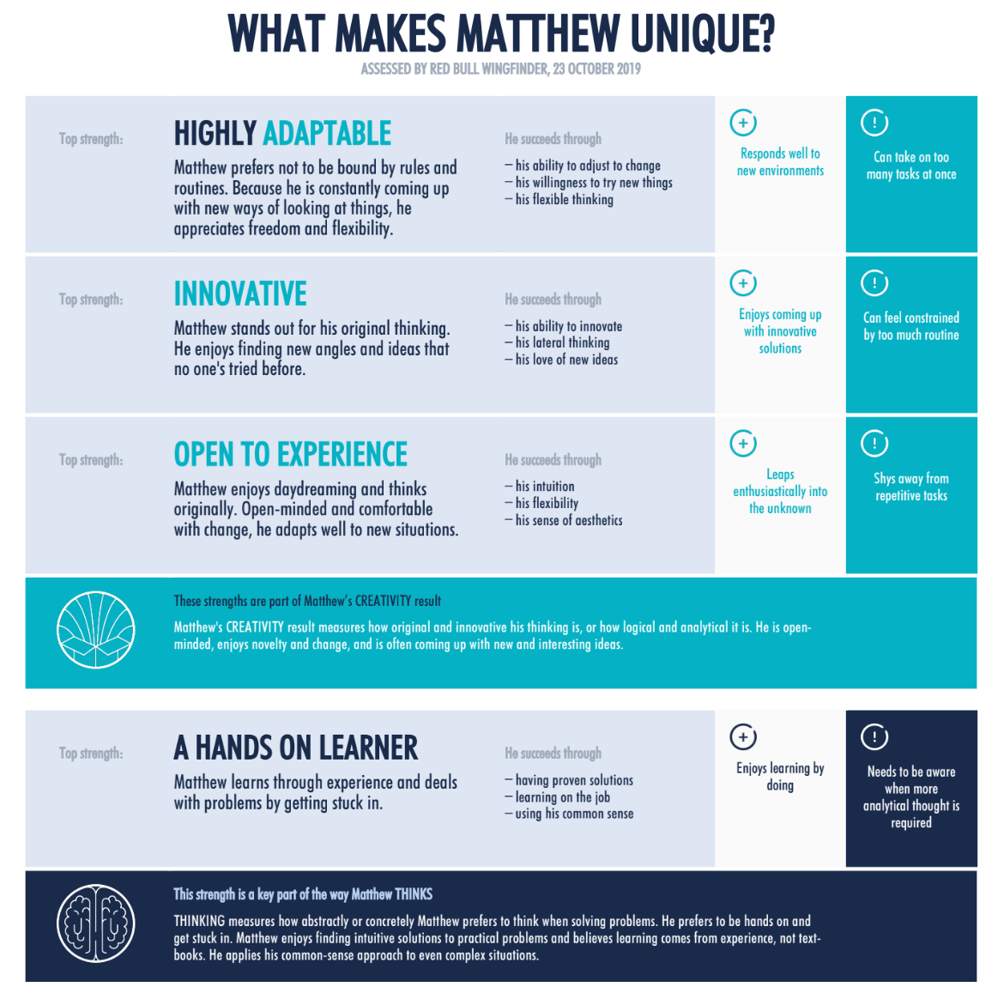

My Results
What am I missing...
Who would I be best matched with?
What about you? Find 1-2 people to complete a group!

